Slide 1

"Exploring 5G Technology"
Concl.
Evolution
Impact
Benefits
Features
Intro

Slide 2
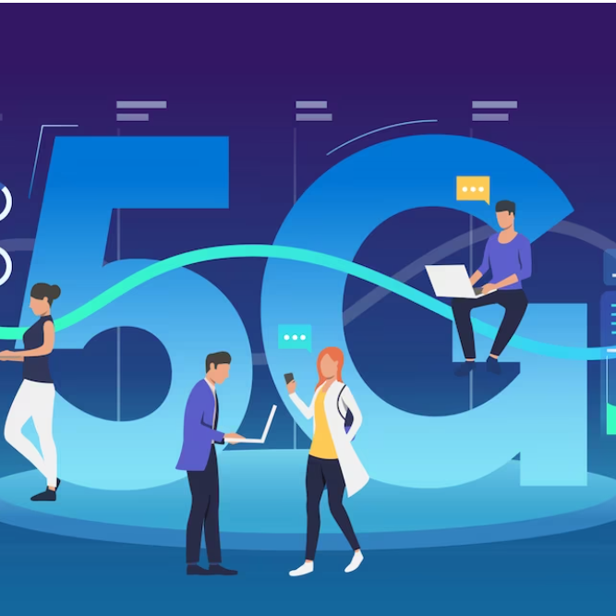
Concl.
Benefits
Evolution
Intro
Impact
Features
Introduction to 5G
The fifth generation of wireless technology.
Faster speeds, lower latency, and broader connectivity.

Slide 3



Adv.
Improv
Integr.
1
2
3
Concl.
Advancements
Improvements
Industry Integration
Evolution
Impact
Benefits
Features
Intro
Faster speeds, greater data capacity.
Reduced latency, enhanced reliability.
IoT support, industry-specific applications.

Slide 4
Concl.
Evolution
Impact
Benefits
Features
Intro
Ultra-Fast
Low
Massive
Speeds
Latency
Connectivity
Up to 100 times faster than 4G
Reduced delay for real-time applications.
Support for massive number of IoT devices

Slide 5

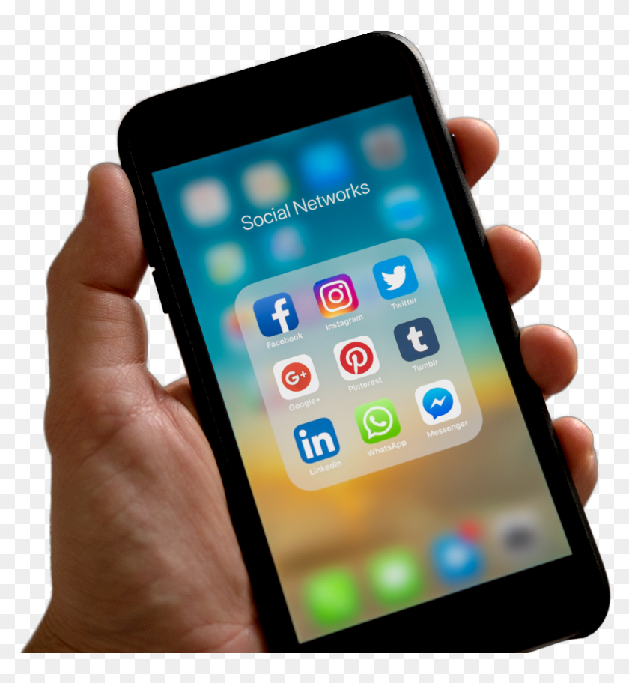

01
02
03
Concl.
Evolution
Impact
Benefits
Features
Intro
Innovation and Future Technology
Improved User Experience
Economic
Growth
Enable new innovations like AI and IoT
Faster downloads and seamless streaming
Enable New Industries and
Job Opportunities

Slide 6






Enhanced Connectivity
Revolutionizing Healthcare
Faster and more reliable internet access for everyone
Telemedicine, remote monitoring, and faster medical data transfer.
Smart Cities
Education Transformation
Evolution
Concl.
Impact
Benefits
Efficient urban planning, improved traffic management and sustainable infrastructure.
Enhanced remote learning experience with high quality video
Features
Intro
Growth
Entertainment
New Industries and job opportunities in 5G related field
Augmented reality (AR), Virtual reality(VR), and immersive media Experience

Slide 7



Concl.
Evolution
Impact
Benefits
Features
Intro
Transformational Impact
Continued Evolution
Future in 5G
Transform our digital landscape by delivering faster speed
5G is not the End Point
5G technology is not just the future, It is the Present

Slide 8
“Thankyou"
Presented by
Mohit Kumar
21BCS5917

